Slide 1
Singular Value Decomposition based Image Authentication systems and its Applications in Telemedicine
Ayantanu Laha
Swarnadeep Das
Rajarshi Saha

Slide 2
content
Abstract
Steganography
Digital Image Watermarking
Area of Interest
Discrete Wavelet Transform
Singular Value Decomposition
Hamming Code
Security Analysis
Gray level Co-occurrence matrix (GLCM)
Principal component analysis (PCA)
Performance Evaluation Technique
Literature Survey
Proposed Method
Method RDWTSVDSVAUTH
Method RDWTSVDUMAUTH
Method RESVDUMAUTH
Datasets
Experimental Results and analysis
Comparison
Reference

Slide 3
1. abstract
Digital watermarking is playing a vital role in the improvement of authentication, security, and copyright protection in today’s digital transformation. The performance of this technique is shown to be impressive around the globe. Text, audio, video, and image data are acted as watermarks in the digital platform.
This hybrid scheme is a form of discrete wavelet transform (DWT) and singular value decomposition (SVD). The embedding and extracting features are carried out through multi-level operations of DWT and SVD. Various attacks are added to the proposed method to justify the robustness of the watermark. In the end, the suggested approach is contrasted with existing methods to confirm the supremacy.

Slide 4
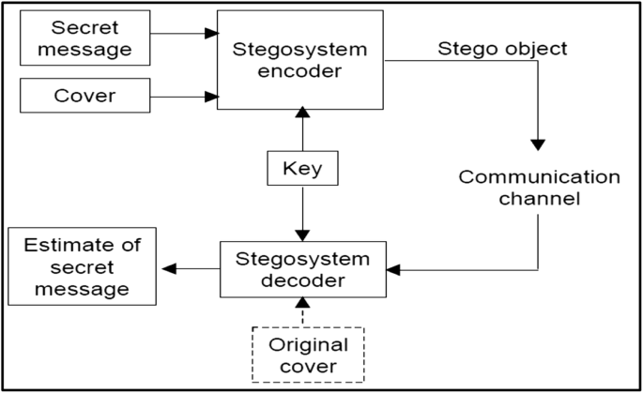
2. steganography
Definition:
Steganography is the art and science of writing hidden/stealth messages in such a way that no one apart from the receiver knows the existence of the message. This can be done by concealing the secret message into cover medium like text, audio, image, videos.

Slide 5
3. Digital Image watermarking
Definition:
Digital image watermarking is a technique in which watermark data is embedded into a multimedia product and later, is extracted from or detected in the watermarked product. These methods ensure tamper-resistance, authentication, content verification, and integration of the image.

Slide 6
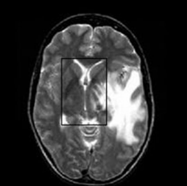
4. Area of interest
Medical Image Authentication in tele-medicine domain.

Slide 7
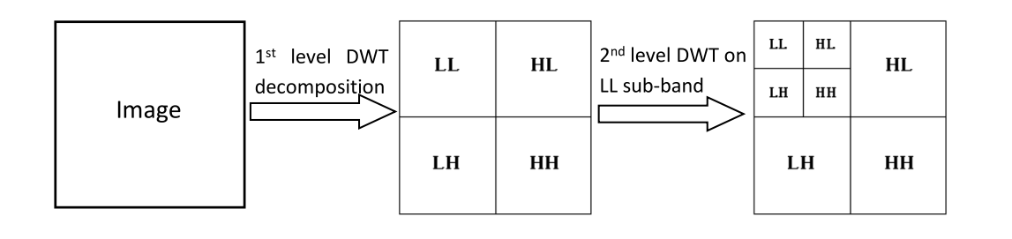
5. Discrete Wavelet Transform (DWT)
DWT is a transform domain technique where any signal can be analysed into its average and detail sub-bands. The DWT is used to decompose the image into non-overlapping sub-bands, namely, approximation (LL), horizontal (LH), vertical (HL) and diagonal (HH). We can further decompose the ‘LL’/or other sub-band to obtain wavelet coefficients at multiple level.

Slide 8
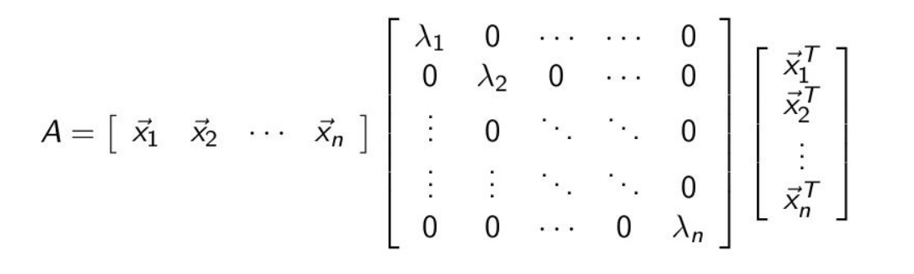
6. Singular Value decomposition (SVD)
SVD reduces an image of any size into smaller invertible and square matrices. It has good energy compaction properties. SVD of a matrix X of size m x n can be stated as X = U S V^{T} . Here, U and V are orthogonal matrices and S is a diagonal matrix representing the singular values of X in descending order.

Slide 9
7. Hamming Code :
The Hamming code is an error-detecting and error-correcting code used in digital communication and computer memory systems. It was developed by Richard Hamming in the 1950s.
The Hamming code adds extra parity bits to a data sequence to detect and correct single-bit errors. The parity bits are inserted at specific positions in the data sequence, creating a larger code word.

Slide 10
8. Security Analysis :
Process of evaluating vulnerabilities, threats, and risks to identify weaknesses in a system's security measures.
Types of attacks :
Passive attack (Steganalysis)
Active attack
Gaussian filter
Median filter
Jpeg compression
Salt & pepper
Crop
Histogram Equalization

Slide 11

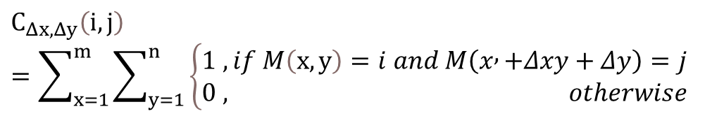
9. Gray Level Co-occurrence Matrix (GLCM):
Analyzes spatial relationships between pixels in an image to capture texture information and spatial patterns.
Derived from the GLCM matrix, texture features quantify the texture properties of the image. Common features include contrast, homogeneity, energy, entropy, and correlation.
GLCM provides a quantitative representation of texture, enabling the characterization and differentiation of textures in image analysis tasks.
$∆x is the$difference in vertical pixel position
$∆y$ is difference in horizontal pixel positions
G is the gray levels in the image M
The size of C is G x G
$$C_{Δx,Δy}\left(i,j\right)=\sum_{x=1}^{m}{\sum_{y=1}^{n}{\left\{\begin{aligned}&1 ,if M\left(x,y\right)=i and M\left(x , +Δxy+Δy\right)=j \\ &0 , otherwise\end{aligned}\right.}}$$

Slide 12
10. Principal Component Analysis (PCA) feature of average GLCM:
Principal Component Analysis is a dimensionality reduction technique that transforms correlated variables into uncorrelated variables called principal components.
Average GLCM calculates the mean value of multiple GLCMs, providing a representative summary of texture information across the dataset.
Applying PCA to the average GLCM involves performing PCA on the elements of the average GLCM matrix.
PCA reduces dimensionality while retaining essential characteristics of the original GLCM, enabling efficient analysis, classification, and visualization of texture features.

Slide 13
11. Performance evaluation techniques
For evaluating the different aspects of image watermarking, different metrics are used . Some of the popular metrics include Peak Signal to Noise Ratio, Structured Similarity Index Measure (SSIM) & Normalized Cross Correlation. The different metrics used are defined next:

Slide 14


11.1 Peak signal to noise ratio (PSNR)
. PSNR is one of the popular and top notch metric used to measure the quality of the watermarked-image by analyzing the mean squared error value between the Cover and the watermarked-image. For 8-bit images, PSNR is calculated as:
And MSE is calculated as:
N is the number of cover image pixels, C_{i} is the intensity of i^{th} pixel in the watermarked-image and C_{i}’ is the intensity of i^{th} pixel in the cover image.

Slide 15
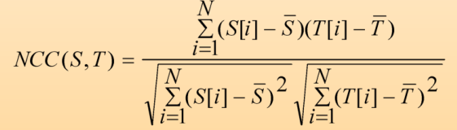
11. 2 Normalized Cross Correlation(NCC)
NCC is a measure to detect level of correlation or similarity between two signals. If the signals are highly correlated the value approaches 1 and becomes 1 when two signals are exactly same. On the other hand, NCC=-1 signifies the signals has no similarity at all. For two discrete one dimensional signals S and T each with N elements:

Slide 16
11.3 Robustness Check
The watermarked image is affected with various active attacks.
In our method only Salt & Peeper Noisy image get retrieved till now.

Slide 17
12. Literature Survey
SL No | Author | Paper | Method | Result | Year
1 | Rania A. Ghazy, Nawal A. El-Fishawy, Mohiy M.Hadhoud, Moawad I. Dessouky and Fathi E. Abd El-Samie | An Efficient Block-by-Block SVD-Based Image Watermarking Scheme | Blocked Based, SVD | Before Embedding Correlation coefficient = 0.9975, After the Extraction it was 0.8308. | 2007
2 | Falgun N. Thakkar Vinay Kumar Srivastava | A blind medical image watermarking: DWT-SVD based robust and secure approach for telemedicine applications | DWT, block-based SVD, Hamming Code. | PSNR = 44.0333 dB SSIM = 0.9673 | 2016
3 | Ranjeet Kumar Singh, Dillip Kumar Shaw, Jayakrushna Sahoo | A secure and robust block-based DWT-SVD image watermarking approach. | 2nd level DWT of the original image. choose LL2 sub-band & convert it into 8X8 blocks. SVD to each component. | Impact of noise: Gaussian noise(0.002): CC=0.9584 | 2017
4 | Sunesh, Vinita Malik, Neeti Sangwan and Sukhdip Sangwan | Digital Watermarking using DWT-SVD Algorithm | DWT, SVD | Embedding: PSNR = 35.6922 Extraction: PSNR = 14.3917 | 2017

Slide 18
SL. No | Author | Paper | Method | Result | Year
5 | Ashima Anand, Amit Kumar Singh | An improved DWT-SVD domain watermarking for medical information security. | 2nd Level DWT – SVD with Hamming code & various compression technique like LZW. | PSNR = 36.1007 dB NC = 0.9251 (Salt & Peeper Noise with 0.001 density) | 2020
6 | Ezz El-Din Hemdan | An efficient and robust watermarking approach based on single value decompression, multi-level DWT, and wavelet fusion with scrambled medical images. | 3rd level DWT, Arnold transforms or chaotic backer map, SVD | PSNR=54.1569 dB(Gain factor=0.1) | 2020
7 | Fauzia Yasmeen,· Mohammad Shorif Uddin | An Efficient Watermarking Approach Based on LL and HH Edges of DWT–SVD. | 3 and 4 level DWT & 1 and 2 level SVD. | PSNR = 43.8362 dB (Grayscale) PSNR = 34.7266 dB (Color) | 2021
8 | Narima Zermia, Amine Khaldib, Redouane Kafib , Fares Kahlessenaneb , Salah Euschi | A DWT-SVD based robust digital watermarking for medical image security . | DWT, SVD, MD5 algorithm | PSNR = 56.12 MSE = 0.10 SSIM = 0.9998 | 2021

Slide 19
SL. No | Author | Paper | Method | Result | Year
9 | Atianashie Miracle A, Chukwuma Chinaza Adaobi, Eneji Samuel Eneji, Ibe Walter Eyong, Ajie Gospel Ozioma, Angib Maurice Udie | Implementation of medical image watermarking using RDWT and SVD for secure medical data transmission in health care system. | RDWT, IRDWT, SVD | PSNR = 65.456 SSIM = 0.983 NCC = 0.9738 | 2021
10 | Divyanshu Awasthi, Vinay Kumar Srivastava | LWT-DCT-SVD and DWT-DCT-SVD based watermarking schemes with their performance enhancement using Jaya and Particle swarm optimization and comparison of results under various attacks. | DWT, SVD, JAYA and the Particle Swarm Optimization technique | PSNR value in the case of PSO without attack is 42.5765 and in JAYA the value is 44.9488. | 2022
11 | Ahmed A Mohammed, Mohammed A M Abdullah, Sohaib R. Awad, Faris S. Alghareb | A Novel FDCT-SVD Based Watermarking with Radon Transform for Telemedicine Applications. | FDCT-SVD | PSNR=55 dB to 59 dB. | 2022

Slide 20
SL. No | Author | Paper | Method | Result | Year
12 | Atul Kumar Appu, Ghanshyam Prasad Dubey and Nargish Gupta | Designing of a Hybrid DWT-SVD Watermarking Technique of Colour Images with Digital Signature. | DWT SVD watermarking technique for the YCbCr color model. | The PSNR value after extraction without any attack is 30.95 dB. | 2022
13 | Ms R. Radha Kumari, V. Vijaya Kumar, K. Rama Naidu | Digital image watermarking using DWT-SVD with enhanced tunicate swarm optimization algorithm | DWT, SVD, TSA optimization, AT scrambling and chaotic Tent map | PSNR = 82.56dB, NC = 0.999, and SSIM = 0.999. | 2023
14 | Shiva Sattarpour | Robust optimal image watermarking using graph-based and discrete wavelet transforms, and whale optimization algorithm. | DWT, SVD, Graph-based transform (GBT) | PSNR = 36dB | 2023

Slide 21
SL. No | Author | Paper | Method | Result | Year
15 | Payel Garg, Ajit Jain | A robust technique for biometric image authentication using invisible watermarking. | DWT, SVD | PSNR = 50.43 (Medical Image) PSNR = 51.06 (Non Medical Image) | 2023

Slide 22
13. Proposed Methodologies : 13.1 Robust DWT based Image authentication using S matrix of Block based SVD (RDWTSVDSVAUTH)
Embedding Process :
In our progress so far, we have broke down the host image into 4 sub-bands using 2D DWT.
Then we divided the LL sub-bands of the image into non-overlapping 2x2 parts.
SVD is taken of all the 2x2 parts.
Watermark image data is embedded into the S matrix of the SVD’s.
The secret key (i.e, the old S matrix) is stored in the SV’s of HH sub-band.
After that inverse SVD is performed and 2x2 parts are merged to make the new LL.
Finally IDWT is performed to generate the watermarked image.

Slide 23
Extraction Process :
Firstly watermarked image is divided into 4 sub-bands using 2D DWT.
LL sub-band is divided into non-overlapping 2x2 sub parts.
SVD of each 2x2 sub parts is taken.
The secret key is then extracted from HH sub-band.
Using the secret key, the watermark image is reconstructed from the 2x2 sub parts.

Slide 24
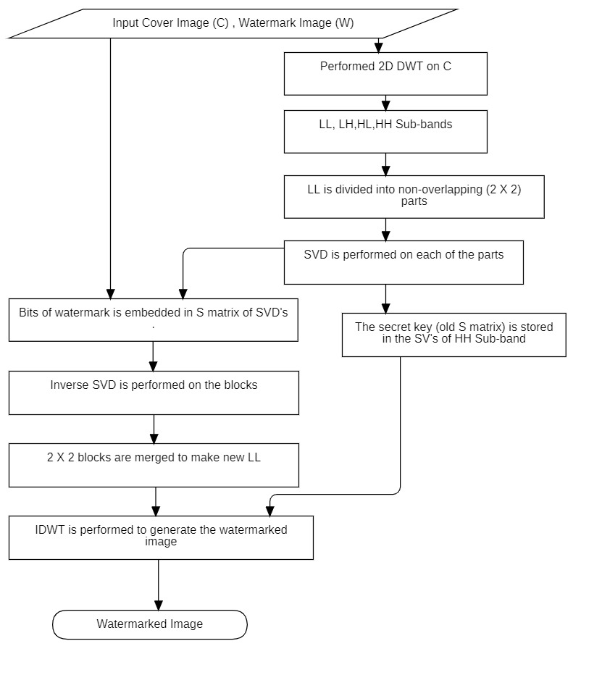
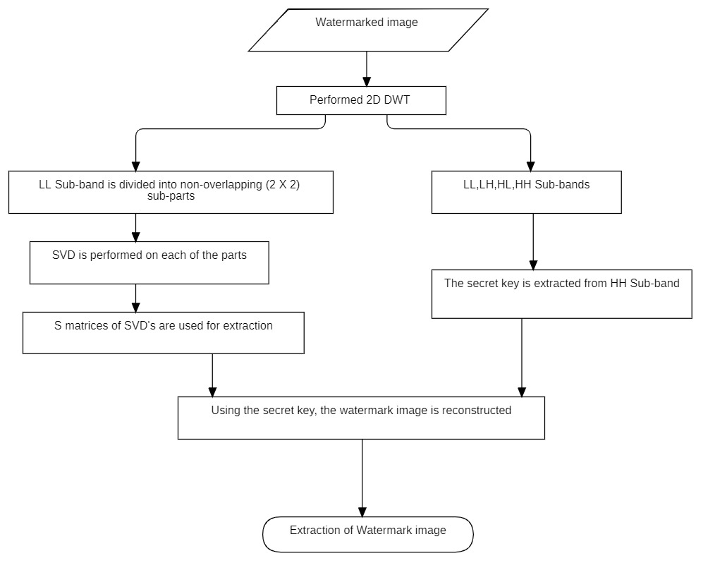
Embedding Process:
Extraction Process:

Slide 25
Result ,Analysis & Comparison
Payload: 128X128 bytes = 131072 bits
Dataset:
Bossbase Dataset(Host Image)
USC SIPI Dataset(Watermark)

Slide 26
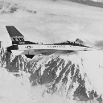
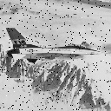
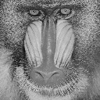
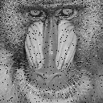

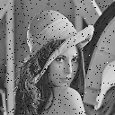
Sample experimental result (Salt & Peeper Noise at 0.001 density)
Image | Watermark (131072 bits) | NCC | PSNR | Watermark | Retrieved
1005.pgm | airplane.tiff | 0.887519 | 40.17271
1005.pgm | baboon.tiff | 0.914029 | 40.18334
1005.pgm | lena.tiff | 0.941054 | 40.18381

Slide 27
Conclusion
We have achieved good PSNR and NCC.
We will modify this further by encrypt the watermark using various encryption method for more security.
We will also try to implement some error correction code for more security.
We have thought of another method to gain the robustness.

Slide 28
13.2. Robust DWT based Image authentication using U matrix of Block based SVD (RDWTSVDUMAUTH) :
Embedding Algorithm :
We have changed the watermark embedding process in the SVD.
In this method we have taken the U matrix of 2x2 SVD’s.
Then we have used 2 values of U matrix to embed the watermark.
Inverse SVD is taken to re-construct each block.
Re-join the blocks to get new_LL.
IDWT is taken to get the watermarked image.

Slide 29
Algorithm: Watermark bit embedding
If watermark bit it 0 :
If U(0,0) < U(1,0) :
Interchange U(0,0) and U(1,0)
If U(0,0) – U(1,0) < K :
U(0,0) = U(0,0) + K/2
U(1,0) = U(1,0) – K/2
If watermark bit is 1 :
If U(0,0) > U(1,0) :
Interchange U(0,0) and U(1,0)
If U(1,0) – U(0,0) < K :
U(0,0) = U(0,0) - K/2
U(1,0) = U(1,0) + K/2

Slide 30
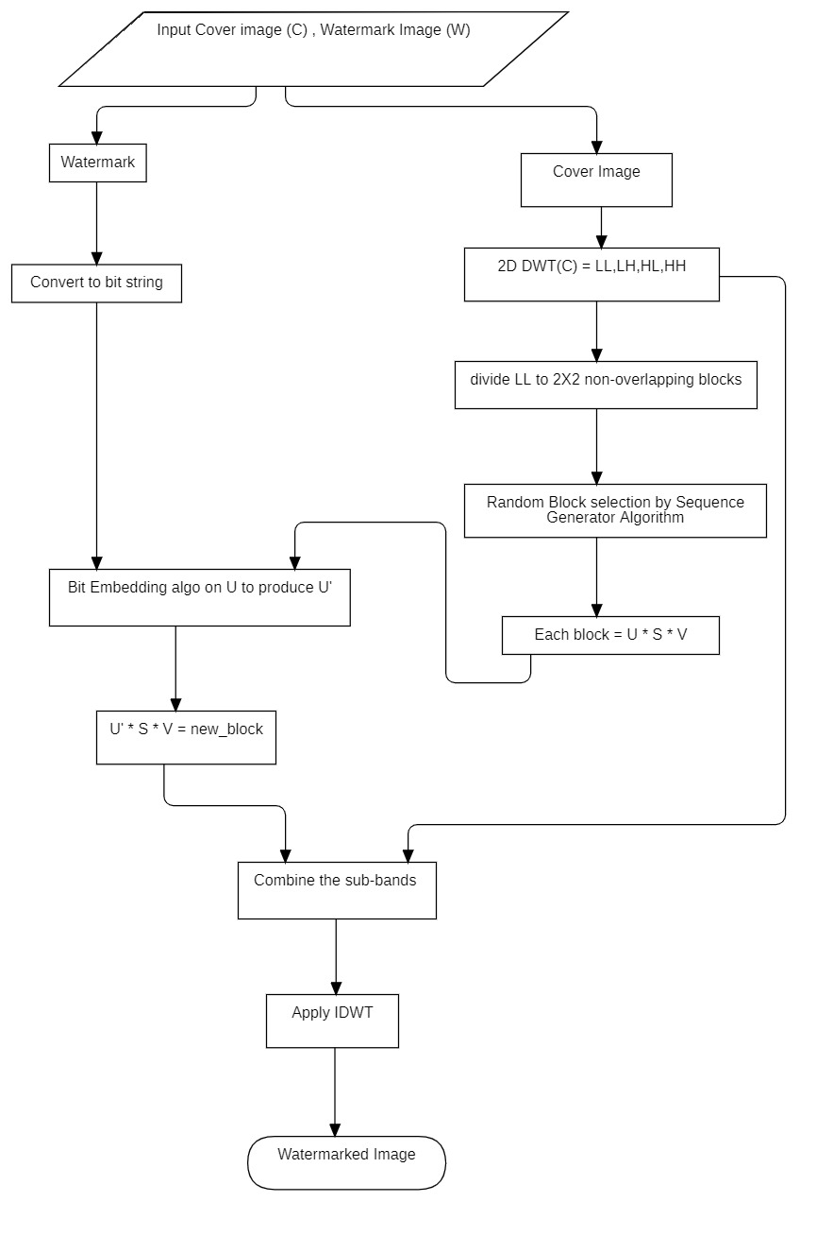
Embedding Process flowchart:

Slide 31
Algorithm: Watermark bit extraction
if U(0,0) < U(1,0):
Watermark bit is 1
else:
Watermark bit is 0

Slide 32
Extraction process :
DWT of watermarked image is taken .
LL sub-band is divided into 2X2 non-overlapping blocks.
Block sequence generator algorithm is applied to select blocks.
SVD of each blocks is taken for each blocks according the sequence.
U matrix is taken and bit extraction algorithm is applied to extract watermark bits.
Bits are merged and binary strings are converted to watermark format.

Slide 33
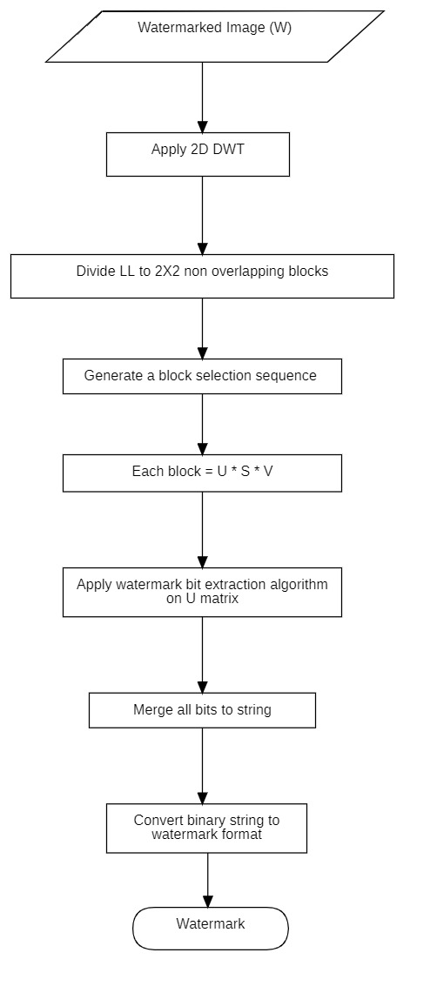
Extraction Algorithm flowchart :

Slide 34






Sample experimental result (Salt & Peeper Noise at 0.001 density)
Image | Watermark (8192 bits) | NCC | PSNR | Watermark | Retrieved
1002.pgm | airplane.tiff | 0.961338 | 30.61746
1002.pgm | baboon.tiff | 0.981083 | 30.26869
1005.pgm | lena.tiff | 0.975234 | 30.60655

Slide 35
Conclusion
Payload: 32X32 Bytes= 8192 bits
We have achieved good NCC score.
But the PSNR for various active attack is very poor.

Slide 36
13.3 . Robust Error correction-based Image authentication using U matrix of Block based SVD (RESVDUMAUTH) :
Embedding Algorithm :
Here we have used the spatial domain instead of frequency domain
Applied hamming code for every 8 bit of watermark
Divided the cover image into 2X2 non-overlapping blocks in spatial domain
Applied the sequence generator algorithm to generate block sequence
Applied SVD on each of the blocks
Applied bit embedding algorithm to change the U matrix
Inverse SVD is applied and blocks are re-joined to get the watermark image

Slide 37
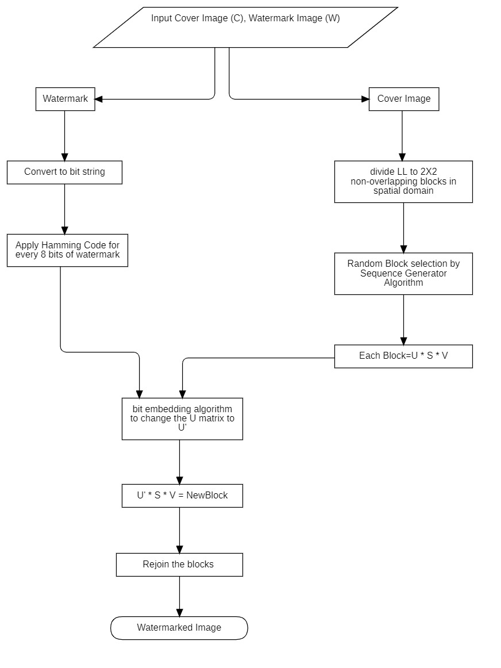
Embedding Process Flowchart :

Slide 38
Extraction process :
Watermarked image is divided into 2X2 non-overlapping blocks.
Sequence generator algorithm is applied to generate block sequence.
SVD is applied on each blocks according to the sequence.
U matrix is taken and bit extraction algorithm is applied to extract the watermark bits.
All bits are merged and hamming code error correction is applied to correct the single bit errors.
Binary string is converted to watermark format.

Slide 39
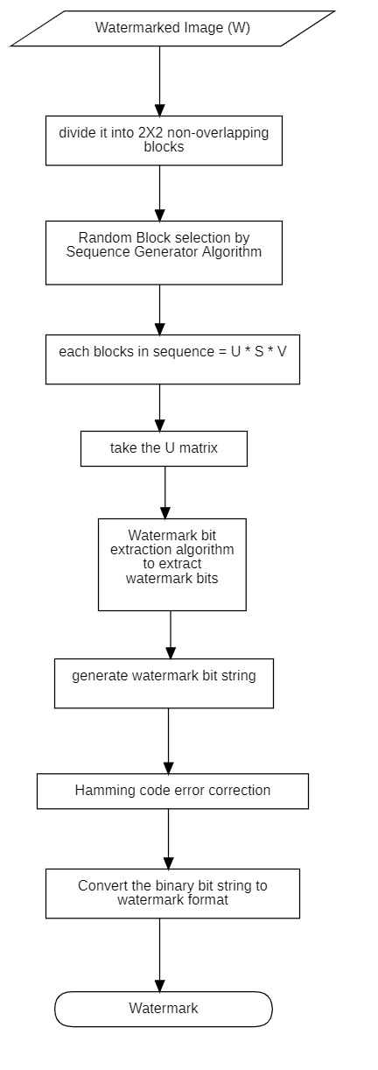
Extraction algorithm flowchart :

Slide 40
Conclusion:
Payload : 32 X 32 X 12 = 12288 bits
We have achieved vary good NCC score and hence robustness.
PSNR is better than RDWTSVDUMAUTH.

Slide 41
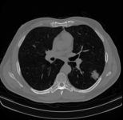
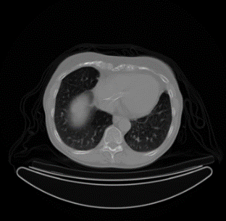
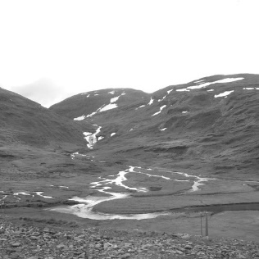

14. Datasets:
USC SIPI Image Dataset:
BOSSbase Image Dataset:
Medical Image Dataset:

Slide 42
15. Experimental results and analysis:
RDWTSVDSVAUTH results :
Table : NCC value of extracted watermark image under salt & pepper noise of 0.001 density
Cover Image | Watermark Image | NCC | PSNR
1063.pgm | Goldhill.tif | 0.951125 | 54.29117
1082.pgm | house.tiff | 0.906952 | 45.13591
1058.pgm | lena.tiff | 0.939768 | 48.76279
1062.pgm | baboon.tiff | 0.911922 | 48.19379

Slide 43
Table : NCC value of extracted watermark image under gaussian noise with variance 0.001
Cover Image | Watermark Image | NCC | PSNR
1063.pgm | Goldhill.tif | 0.819854 | 54.29117
1082.pgm | house.tiff | 0.823249 | 45.13591
1058.pgm | lena.tiff | 0.868613 | 48.76279
1062.pgm | baboon.tiff | 0.82369 | 48.19379
Table : NCC value of extracted watermark image under JPEG compression
Cover Image | Watermark Image | NCC | PSNR
1011.pgm | Goldhill.tif | 0.033205 | 36.24174
1013.pgm | house.tiff | 0.073048 | 41.66139
10.pgm | lena.tiff | 0.024879 | 38.40452
1007.pgm | baboon.tiff | 0.013044 | 33.30988

Slide 44
RDWTSVDUMAUTH results :
Table : NCC value of extracted watermark image under JPEG compression
Cover Image | Watermark Image | NCC | PSNR
10.pgm | lena.tiff | 0.972377 | 23.40228
1005.pgm | baboon.tiff | 1 | 27.86258
1001.pgm | airplane.tiff | 0.858322 | 30.18773
1.pgm | airplane.tiff | 1 | 30.61746
Table : NCC value of extracted watermark image under histogram equalization
Cover Image | Watermark Image | NCC | PSNR
10.pgm | lena.tiff | 0.972377 | 23.40228
1005.pgm | baboon.tiff | 1 | 27.86258
1001.pgm | airplane.tiff | 0.858322 | 30.18773
1.pgm | airplane.tiff | 1 | 30.61746

Slide 45
Table : NCC value of extracted watermark image under median filter
Cover Image | Watermark Image | NCC | PSNR
10.pgm | lena.tiff | 0.635886 | 23.40228
1005.pgm | baboon.tiff | 0.761992 | 27.86258
1001.pgm | airplane.tiff | 0.649695 | 30.18773
1.pgm | airplane.tiff | 0.751055 | 30.61746

Slide 46
RESVDUMAUTH results:
Table : NCC value of extracted watermark image under JPEG compression
Cover Image | Watermark Image | NCC | PSNR
airplane.tiff | peeper.tiff | 1 | 37.52934
elaine.tiff | splash.tiff | 1 | 36.84927
lena.tiff | peeper.tiff | 1 | 36.56643
tank.tiff | splash.tiff | 1 | 37.23136
Table : NCC value of extracted watermark image under gaussian noise
Cover Image | Watermark Image | NCC | PSNR
airplane.tiff | peeper.tiff | 1 | 35.31552
elaine.tiff | splash.tiff | 1 | 35.12001
lena.tiff | peeper.tiff | 1 | 33.41158
tank.tiff | splash.tiff | 1 | 37.3193

Slide 47
Watermarking results after JPEG Compression, (a) Cover Image, (b) Watermark image, (c) Watermarked image after attack, (d) Retrieved Watermark

Slide 48
Watermarking results after applying histogram equalization, (a) Cover Image,
(b) Watermark image, (c) Watermarked image after the attack, (d) Retrieved Watermark

Slide 49
Watermarking results without performing an attack on lena.tiff image (a) Cover Image, (b)Watermark image, (c) Retrieved Watermark

Slide 50
Watermarking results on the medical image, (a) Cover Image, (b) Watermark image, (c) Watermarked image after watermarking, (d) Retrieved Watermark

Slide 51
Watermarking on the medical image with EPR data, 49.82 dB PSNR is achieved (a)Cover Image, (b) Watermarked Image

Slide 52
16. Comparison
Average NCC value comparison between proposed and existing scheme [5] for watermark image using medical image under gaussian noise attack

Slide 53
Average NCC value comparison between proposed and existing scheme [5] for watermark image using medical image under salt and pepper noise attack

Slide 54
NCC value comparison between proposed and existing scheme [11] for watermark image using BrainCT medical image under various active attack

Slide 55
NCC and PSNR value comparison between proposed and existing scheme [5] for watermark image using USC SIPI image with no attack

Slide 56
17. References
R. A. Ghazy, N. A. El-Fishawy, M. M. Hadhoud, M. I. Dessouky and F. E. A. El-Samie, "An Efficient Block-by-Block SVD-Based Image Watermarking Scheme," 2007 National Radio Science Conference, Cairo, Egypt, pp. 1-9, doi: 10.1109/NRSC.2007.371376. (2007)
F. N. Thakkar, V. K. Srivastava, “A blind medical image watermarking: DWT-SVD based robust and secure approach for telemedicine applications.” Multimed Tools Appl 76, 3669–3697 (2017). https://doi.org/10.1007/s11042-016-3928-7
R. K. Singh, D. K. Shaw & J. Sahoo “A secure and robust block-based DWT-SVD image watermarking approach.” Journal of Information and Optimization Sciences, pp. 911-925, DOI: 10.1080/02522667.2017.1372137
Sunesh, V. Malik, N. Sangwan, S. Sangwan “Digital Watermarking using DWT-SVD Algorithm” Advances in Computational Sciences and Technology ISSN 0973-6107 Volume 10, Number 7, pp. 2161-2171 © Research India Publications. (2017)

Slide 57
5. A. Anand, A. K. Singh, “An improved DWT-SVD domain watermarking for medical information security”, Computer Communications Vol.152 pp.72–80, ISSN 0140-3664, (2020)
6. Hemdan, E.ED. An efficient and robust watermarking approach based on single value decompression, multi-level DWT, and wavelet fusion with scrambled medical images. Multimed Tools Appl 80, 1749–1777 (2021). https://doi.org/10.1007/s11042-020-09769-7
7. Yasmeen, F., Uddin, M.S., “An Efficient Watermarking Approach Based on LL and HH Edges of DWT–SVD.” SN COMPUT. SCI. 2, 82 (2021). https://doi.org/10.1007/s42979-021-00478-y
8. N. Zermia, A. Khaldib, R. Kafib, F. Kahlessenaneb, S. Euschi “A DWT-SVD based robust digital watermarking for medical image security.”, Forensic Science International, Volume 320, 110691, ISSN 0379-0738. (2021)

Slide 58
9. A. Miracle A, C. C. Adaobi, E. S. Eneji, I. W. Eyong, A. G. Ozioma, A. M. Udie “Implementation of medical image watermarking using RDWT and SVD for secure medical data transmission in healthcare systems.” https://www.stujournal.org [Original Article]. Vol 6 Issue 1, pp. 78-83. (2021)
10. D. Awasthi, Srivastava, V.K., “LWT-DCT-SVD and DWT-DCT-SVD based watermarking schemes with their performance enhancement using Jaya and Particle swarm optimization and comparison of results under various attacks.” Multimed Tools Appl 81, 25075–25099 (2022). https://doi.org/10.1007/s11042-022-12456-4
11. A. A. Mohammed, M. A M Abdullah, S. R. Awad “A Novel FDCT-SVD Based Watermarking with Radon Transform for Telemedicine Applications” International Journal of Intelligent Engineering and Systems, Vol.15, No.1 (2022)
12. A. K. Appu, G. P. Dubey and N. Gupta, "Designing of a Hybrid DWT-SVD Watermarking Technique of Colour Images with Digital Signature." IEEE International Conference on Current Development in Engineering and Technology (CCET), Bhopal, India, pp. 1-6, doi: 10.1109/CCET56606.2022.10080560. (2022)

Slide 59
13. Kumari, M.R.R., Kumar, V.V. & Naidu, K.R., “Digital image watermarking using DWT-SVD with enhanced tunicate swarm optimization algorithm.” Multimed Tools Appl (2023). https://doi.org/10.1007/s11042-023-14618-4
14. S. Sattarpour, “Robust optimal image watermarking using graph-based and discrete wavelet transforms, and whale optimization algorithm.” Multimed Tools Appl 82, 6667–6685 (2023). https://doi.org/10.1007/s11042-022-13639-9
15. P. Garg, A. Jain, “A robust technique for biometric image authentication using invisible watermarking.” Multimed Tools Appl 82, 2237–2253 (2023). https://doi.org/10.1007/s11042-022-13314-z

Slide 60
Thank You

